Slide 1


Building Conversational Chatbots using API.AI
By Fahim Uz Zaman and Alifya Hussain

Slide 2

What is Dialogflow
2

Slide 3
DialogFlow is quite a good choice to learn how to create Chatbots that you can then integrate them into your own websites or Apps .
3

Slide 4
DialogFlow is where the magic happens.
It works on natural language processing and backed by Machine Learning
4

Slide 5
DialogFlow is backed by Google and runs on Google infrastructure, which means
you can scale to millions of users.
5

Slide 6
32
Why Choose Dialogflow ?
“

Slide 7
Small Talk
Fast Coding
On any platform — Dialogflow support more than 20+ platforms from Google home to Twitter
Across devices — Dialogflow supports all the devices from wearables , to phones to devices.
Around the world — Dialogflow supports more than 14+ languages worldwide & more support is coming.

Slide 8
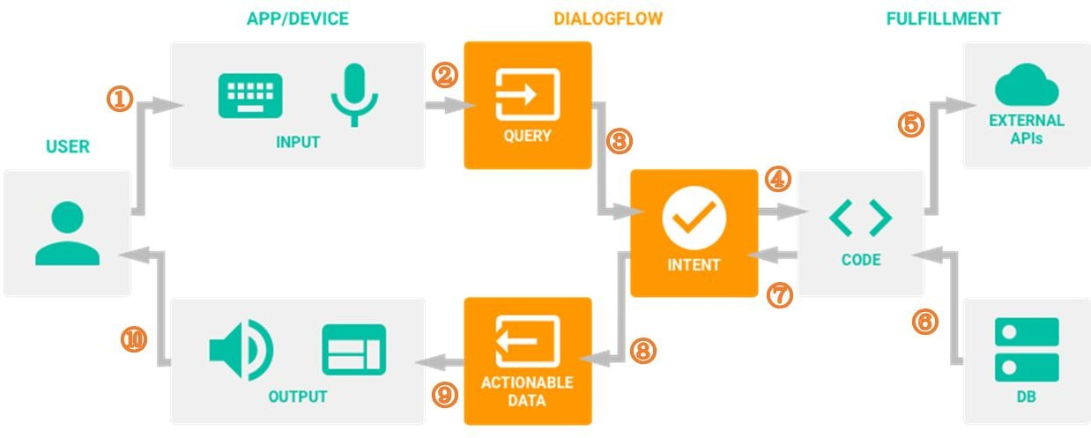
How do Chatbots Dialogflow work?

Slide 9
Entity
Variable/parameter for entity
Important word to an input
Possibly maps to domain object
Entity Courses :
Maths
Economic
Algorithms

Slide 10
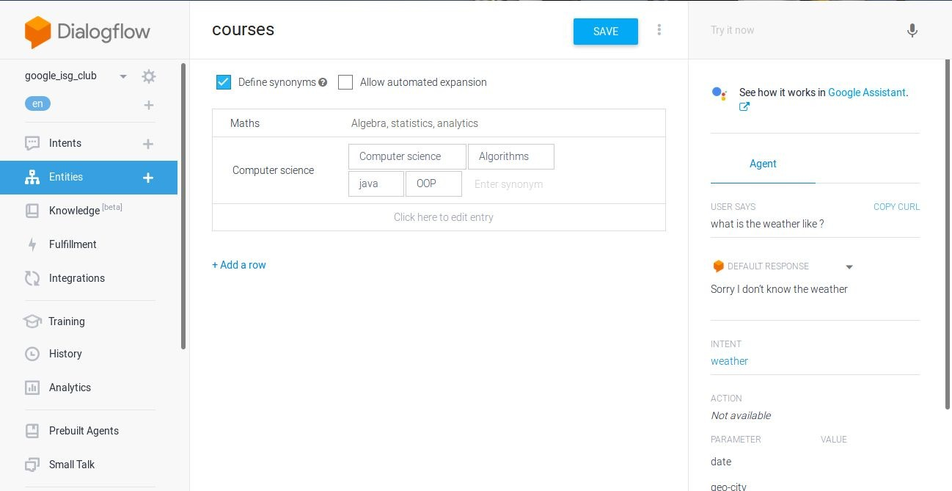
Entity

Slide 11
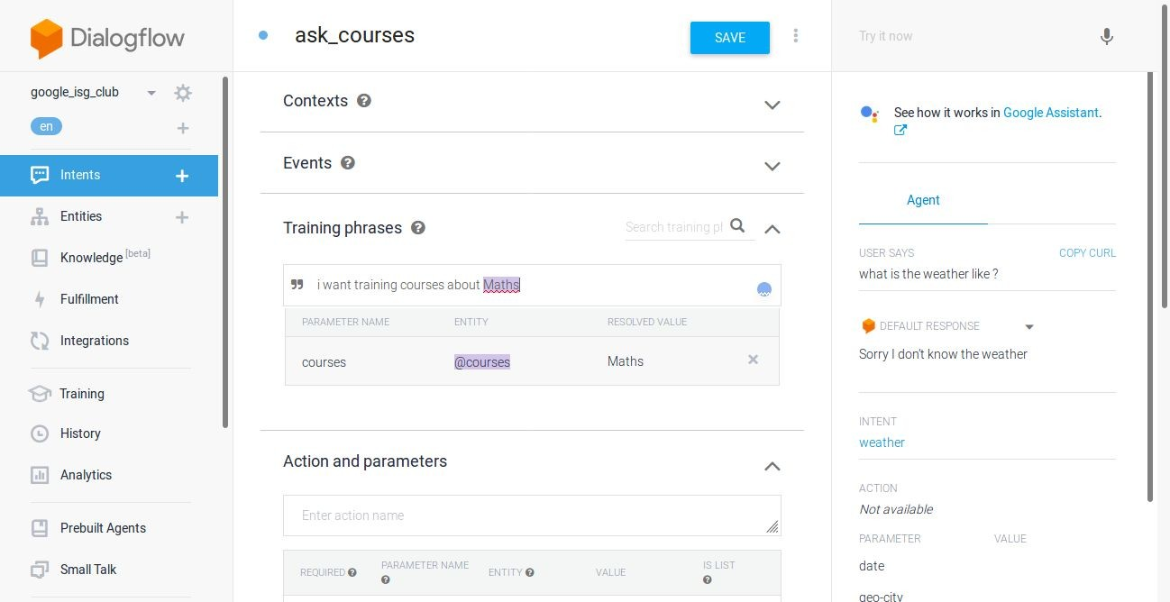
Entity

Slide 12
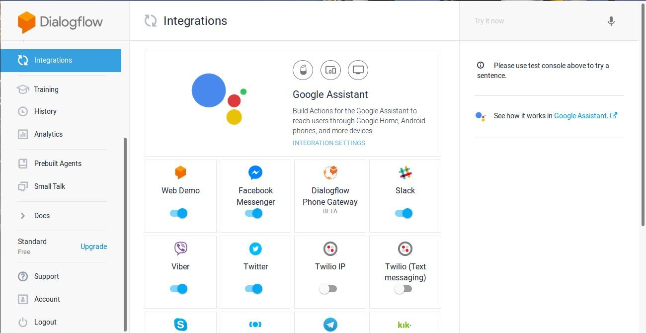
Integrations

Slide 13
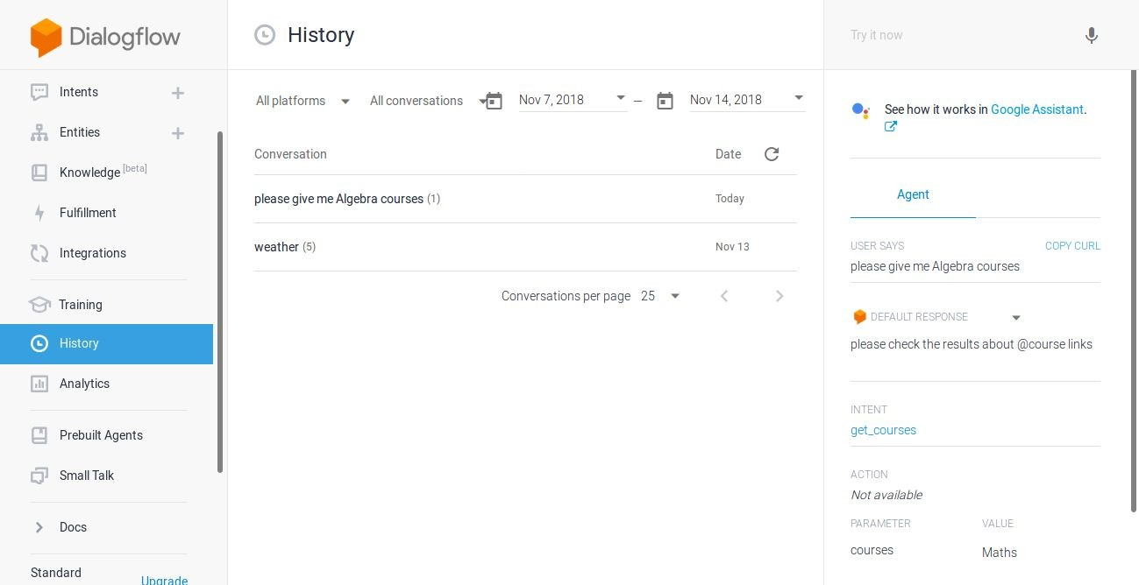
History

Slide 14
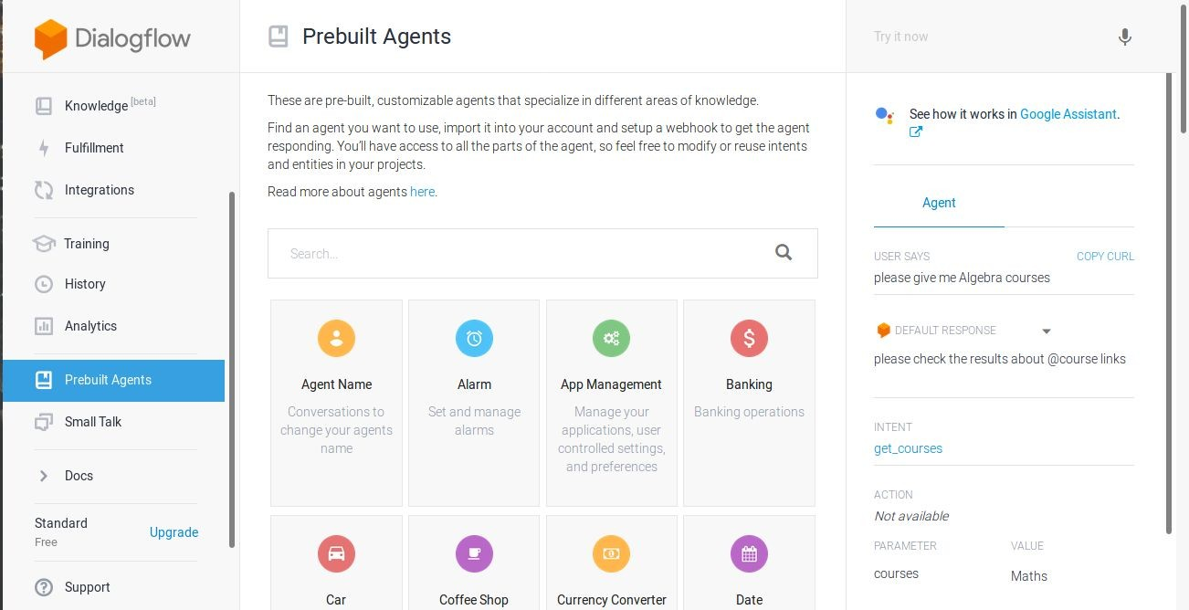
Prebuilts Agents

Slide 15
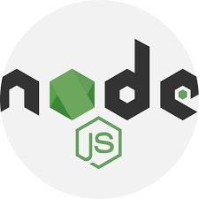
Basic Fulfillment(Webhook)
Depending on your need, you can define custom Webhook to use external APIs and get extra data from external databases. A webhook can be written in Node.js and many Languages.

Slide 16
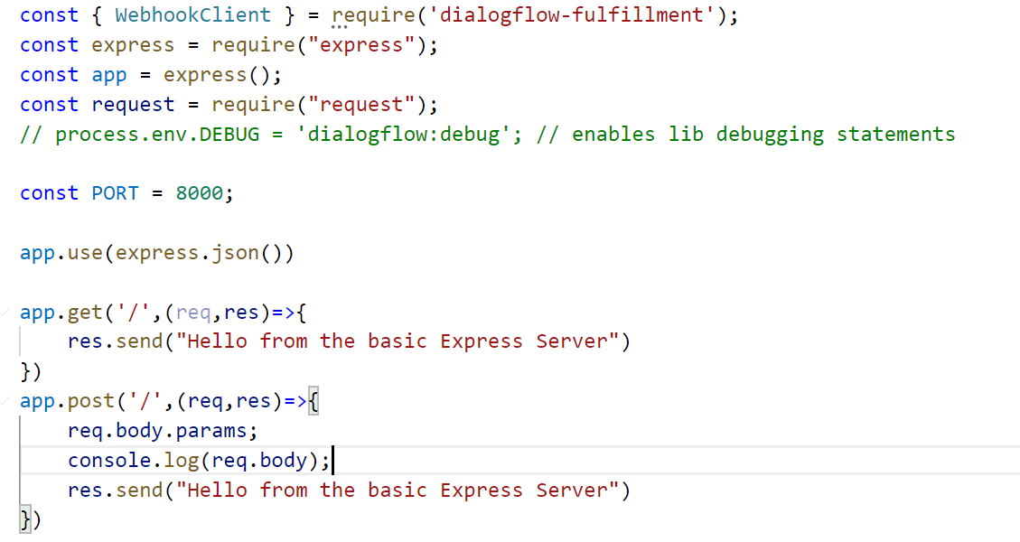
Nodejs Code

